Slide 1
Welcome to Week 14, Lecture 01!
APIs & JSON

Slide 2
Agenda
APIs
JSON
File Paths
CodeAlong: Mapping Yelp API Results - Part 1

Slide 3
Assignments
This week’s assignments:
Efficient Yelp API Calls (Core)*
Project 3 - Part 2 (Core)*
Applying Advanced Transformations (Core)
Deadline extended to Sunday at 11:59 PM!
* = You should be able to complete these after today’s lesson.

Slide 4
APIs

Slide 5
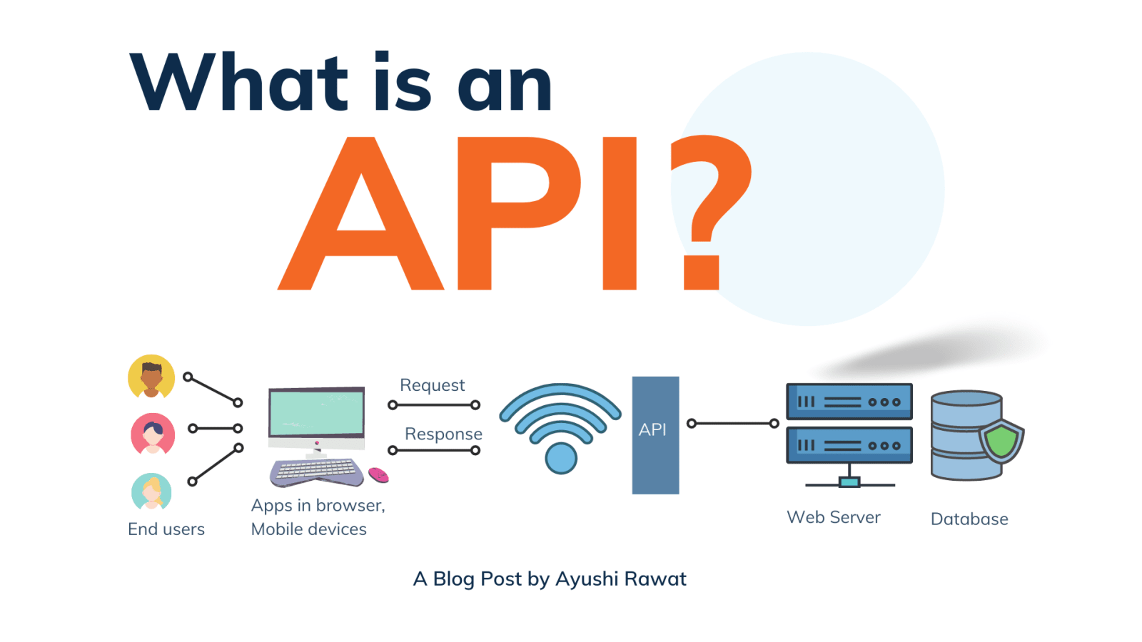
What is an API?
API = “Application programming interface”
A connection between two computers/computer programs.
Structure access/exchange to information.
You are constantly using APIs via Apps and websites without realizing it.
APIs allow data sharing in a structured way that is controlled by the owner of the data.
APIs can have different “endpoints” for different information.
Image Source

Slide 6
What is “Authentication”/”Authorization”?
Whenever you log in to a website with your username and password, you are “authentifying” your identity.
Whenever you log in to a new website using Facebook or Google, you are “authorizing” the new website to use your account.
To avoid constantly using/exposing your username and password, APIs allow you to get an alternative (& safer) way to authenticate users.
We create an “app” for an API (like Yelp, Spotify, etc) - and the app will get special credentials.
Instead of a username and password, our app will usually get a “Client-ID” and “API-Key” (sometimes called a client-secret)
We provide our API key every time we perform a query (called an API “call”).
Using our API-Key lets Yelp (for example) know which account is requesting data.
It will track how many queries you have performed.
Free vs Paid APIs:
Some APIs allow free, but limited access to their data.
Usually limited to a specific # of api calls per month (or day)

Slide 7
Using APIs
Using an API requires getting very familiar with the API’s documentation.
While there is a general framework for the types of API calls that can be made. There is a LOT of variability between APIs.
To use an API, we use a web request.
Requests come in 4 flavors:
GET: Retrieves resources/data.
POST: Creates/provides resources/data.
PUT: Changes or replaces resources/data.
DELETE: Deletes or replaces resources/data.
As a Data Scientist, you will mostly be using GET requests.
We can manually construct these requests using Python “requests” package. (See Optional lesson for more).
BUT there are usually Python packages for an API that make it easier to use.

Slide 8
JSON

Slide 9
JSON: Javascript Object Notation
Most popular data format for API’s.
Lightweight “data-interchange” file format - easy to share/access
Easy for humans to read and write.
Can be easily read and accessed using packages in other systems and languages.
Stores text data in a hierarchical structure.
Uses Key: Value pairs separated by commas (like dictionaries).
Also uses lists/arrays

Slide 10
JSON File Requirements
Json Objects/Files must start with a list or a dictionary.
Must start with a [ or {
Must use double quotes instead of a single quotes.
The keys must be strings.
The values can be strings, numbers, lists,boolean, or None.

Slide 11
Example JSON: Three Employees
{"employees":[
{ "firstName":"James", "lastName":"Irving" },
{ "firstName":"Sherlin ", "lastName":"Whaley" },
{ "firstName":"Purvi", "lastName":"Kansara" }
]}

Slide 12
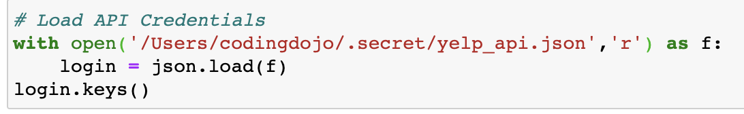
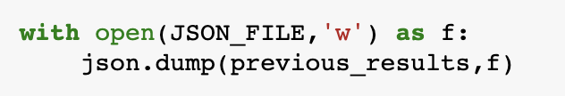
Reading/Writing JSON with Python
Use the JSON module that comes with Python.
json.load: for loading data from a json file
json.dump: for saving data to a json file
To read in data: combine with the Open function using read mode (‘r’)
To save data: combine with the Open function using write mode (‘w’).
Provide the variable to save to json followed by the opened file.

Slide 13
File Paths

Slide 14
File Path Notation
Key File Path string info:
“~/” indicates the “Root Directory” (usually your User folder)
“/” indicates the very top-level directory of your hard drive
E.g. “/” == “C:/”
“./” indicates the CURRENT folder.
“../” indicates the folder ABOVE the current directory.
Windows File Paths:
Use 2 backslashes (\\) instead of a forward-slash (/)
Backslash is a special character so must use two backslashes “\\”
Must also use a backslash before spaces.

Slide 15
Absolute vs Relative File Paths
File Paths that start with a slash (or \\ on Windows) are absolute file paths
Includes every folder from the top-level of the hard drive to the specified file.
Example: “/Users/codingdojo/Documents/GitHub/json-apis-activity/Data”
Relative file paths do not start with a slash and are relative to the location of your file/terminal.
Example: if you are already in the GitHub folder, it would be: “json-apis-activity/Data”
For your Jupyter Notebooks in a repository, ALWAYS USE RELATIVE FILE PATHS FOR YOUR DATA!!
Example absolute file path that will NOT work for others. df = pd.read_csv(“/Users/codingdojo/Documents/GitHub/json-apis-activity/Data/example.csv”)
Instead, use this relative file path: df = pd.read_csv(“Data/example.csv”)
Notes:
Let’s say you’ve cloned a repo called “json-apis-demo” into the GitHub folder inside your Documents folder (the default folder used by GitHub Desktop).
You click on the Repository menu > Open in Terminal/GitBash
You run the “pwd” command (print working directory) and see the following: “/Users/codingdojo/Documents/GitHub/data-enrichment-json-api-activity”

Slide 16
CodeAlong/Activity

Slide 17
Activity Repository
✅ CodeAlong: Mapping Yelp API Results - Part 1:
https://github.com/coding-dojo-data-science/data-enrichment-wk14-mapping-yelp-results
❌ JSON Activity (Breakout Groups):
https://github.com/coding-dojo-data-science/data-enrichment-wk14-l01-json-activity
Activity has a solution branch if you’d like more practice sifting through JSON.

Slide 18
APPENDIX

Slide 19
Example Absolute vs Relative File Path
Let’s say you’ve cloned a repo called “json-apis-activity” into the GitHub folder inside your Documents folder (the default folder used by GitHub Desktop).
You click on the Repository menu > Open in Terminal/GitBash.
The repository included a “Data” folder with a “example.csv” file.
From our terminal, if we wanted to change directories to the Data folder, we use the “cd” command and specify the folder name. We can use either an absolute OR a relative file path:
Example with an absolute file path:
“cd /Users/codingdojo/Documents/GitHub/json-apis-activity/Data”
Example with a relative file path:
“cd Data”

